Slide 1
Computer Architecture

Slide 2
Von Neuman Architecture
As introduced last week specifies the components of a computer system
Control Unit & Arithmetic Logic Unit (ALU)
Shared Store
Data
Program Instructions
Input and Output

Slide 3
Limitations
Shared store means that both instructions and data must be same length (bits)
Can only load instruction or data, not both simultaneously
Leads to performance bottleneck

Slide 4
Harvard Architecture
Implemented in the Harvard Mk 1 (1944)
Part electronic, part mechanical calculator
Program instructions were taken into control unit using paper tape
Data was handled entirely separately using different technology
Instructions were typically:
Where to get the data from
Where to store the result
Which operation to perform

Slide 5
Harvard Architecture Diagram
ALU
Programme
Store
Control Unit
Data Store
I/O

Slide 6
Modified Harvard Architecture
Modern computers tend to implement a modified version of Harvard
External storage (disk/RAM) is a unified store
Within the processor there are separate pathways for instructions and data
Storage within the processor splits data and instructions and both can be loaded at once

Slide 7
Data Storage

Slide 8
Memory Hierarchy
Larger
Disk Memory
RAM
Cache
Registers
Faster

Slide 9
Registers
Within the processor unit there are small blocks of memory know as registers
CPU may have 8 or 16 registers per core
Hold the data that the processor is working on
Processor only performs operations on data held in registers
Take data from a register, add to another and store the result in a register
Transfers data in and out of RAM

Slide 10
Cache
Processors have on-board memory containing recently used data and instructions
Many operations are repetitive (loops) so the same data often needed again and again
Keeping a local copy rather than fetching from RAM or Disk is faster

Slide 11
Cache levels
Typically have multiple types of cache on a CPU known as levels
L1 is closest to the CPU
Fastest
Most expensive
Tends to be small
L2 cache
Bigger
Slightly further away and slower
L3 cache…

Slide 12
Cache Synchronisation
If data needed, cache checked first
If present (cache hit) used straight away
If absent (cache miss) loaded from Ram
If cache is full, some data currently stored must be written back to RAM before new data loaded into cache

Slide 13
Multiple cores
Modern PCs tend to have more than one core
Mixed of dedicated cache for each core and shared L2 or L3 cache
Can potentially have problems if both cores are working on the same data
If different values are in separate caches the data is inconsistent
A locking mechanism can be implemented so that data is consistent

Slide 14
Main Memory
Data and instructions must be present in the main memory (RAM) while they run
Processor fetches data/instr as needed
Data copied to and from disk or other backing store when required

Slide 15
Backing Store
Programs and data not currently in use are stored in slower media such as hard disks
May be local to the computer
Can be network devices
Can be slower media such as tape stores

Slide 16
Paging and swapping
A computer running complex tasks may require much more RAM than is actually available
Uses slower backing store (usually disk) to store some of the memory contents
Both paging and swapping sound similar: they use disk as an extension to RAM
In practice they are different

Slide 17
Swap
Operating system makes a distinction between active and idle processes
Data in active processes need to be in RAM
Data for idle processes can be stored on Disk in the swapfile until the process is re-activated
Typically swapfile is twice the size of the available RAM

Slide 18
Page files
Memory space divided into fixed sized blocks called Frames
Memory requirements for programs divided into same size blocks known as Pages
Total memory space (logical memory) made up of physical memory (RAM) and extended memory (disk)
Pages are copied into RAM when needed and copied back to disk when not
Transparent to applications, managed by OS

Slide 19
PC Architecture
PC typically consists of
Motherboard
CPU
RAM
Disk
Graphics Card (GPU)
Peripherals
Motherboard controls movement of data between these devices
Tight coupling between all elements

Slide 20
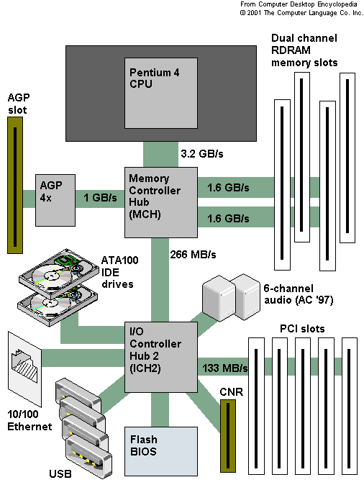
Northbridge/Southbridge
High capacity data connection to RAM and GPU
Slower access for less speed-critical elements like network and audio
Used this model upto newer core i3, i5, i7 processors

Slide 21
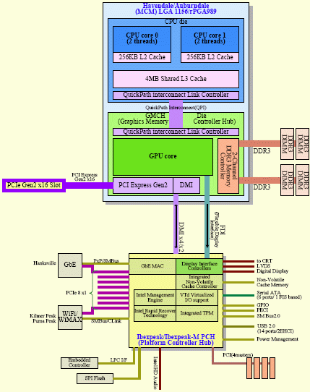
Integrated Memory Controller
Direct memory controller built into CPU
Some processors have integrated graphics (especially laptops)
Slower devices still connected through controller chip like the southbridge

Slide 22
System on a Chip
Even further integration possible
Embed small amounts of RAM on the CPU chip
Phone chips and Raspberry Pis use SoC

